Slide 1

UK ASSI – Rulemaking – Enforcement - Accident Investigation

Slide 2
Introduction
Matthew Bennett
Senior Legal Adviser I Office of the General Counsel & Air Safety Support International
Company Secretary I Air Safety Support International
Email: matthew.bennett@caa.co.uk
Tel: +44 (0)330 138 2104 I (0)7920 823311

Slide 3
Agenda
ICAO Audit of UK and OTs in 2000
ASSI’s remit, structure and relationship with UK CAA
Legal Structure and Role of the Governor
ASSI Rulemaking and Policy
Aviation Security (Av Sec) Regulation
Enforcement
Accident Investigation and role of ASSI

Slide 4
ICAO Audit of UK and UK OTs in 2000
ICAO Audit in 2000 relating to the UK OTs.
Specifically:
  Legislation out of date
  Mixture of FARs, CAPs, JARs¹ etc being used
  No published means of compliance
  Audit findings not followed up
¹Federal Aviation Regulations, Civil Aviation Publications,
Joint Aviation Requirements
ASSI's primary objective is to help provide a more cohesive system of civil aviation safety and security regulation in the United Kingdom Overseas Territories.
Notes:
ICAO audited the UK, including TCI and Bermuda, in 2000. At this time all OTs had their own local civil aviation regulator. ICAO was very scathing about the UK’s oversight of aviation in the OTs. Principally, the findings were around legislation which was woefully out of date and hadn’t kept pace with changes in UK law or with ICAO requirements. There was no published means of compliance with the legislation so a mixture of rules from other States was being used. This basically led to cherry picking the path of least resistance by industry and it was very difficult for the local regulators to know what they were regulating against. ICAO also noted that audit findings were not being followed up.
The UK took this audit result very seriously and contracted Atkins’ consultancy to come up with options to address the findings. After a 2-year long project, ASSI was created in 2003. It should be noted that there was significant resistance to all of the potential solutions offered by Atkins – one of which was that the UK CAA became the regulator for all OTs. This was vehemently resisted by the OTs. There were several reasons for this. The OTs all had a local regulator so there would be job losses if the UK CAA took over. The UK CAA had had a long standing oversight role of the OTs’ local regulators on behalf of the DfT; they would go to the OTs periodically, raise findings and return a couple of years later only to find that there had been no progress in resolving issues. The OTs felt that the UK CAA did nothing to help them improve. They were also very wary of regulator of a sophisticated aviation State imposing additional rules on them. If there was to be some organisation overseeing them, they were clear that that body should focus exclusively on them, and get to know their culture, their industry, their challenges so that an ICAO compliant and proportionate approach could be taken. This is exactly what they got when ASSI was created – a bespoke unit, with its focus on the OTs, and with a remit to support the OTs as well as oversee them.

Slide 5

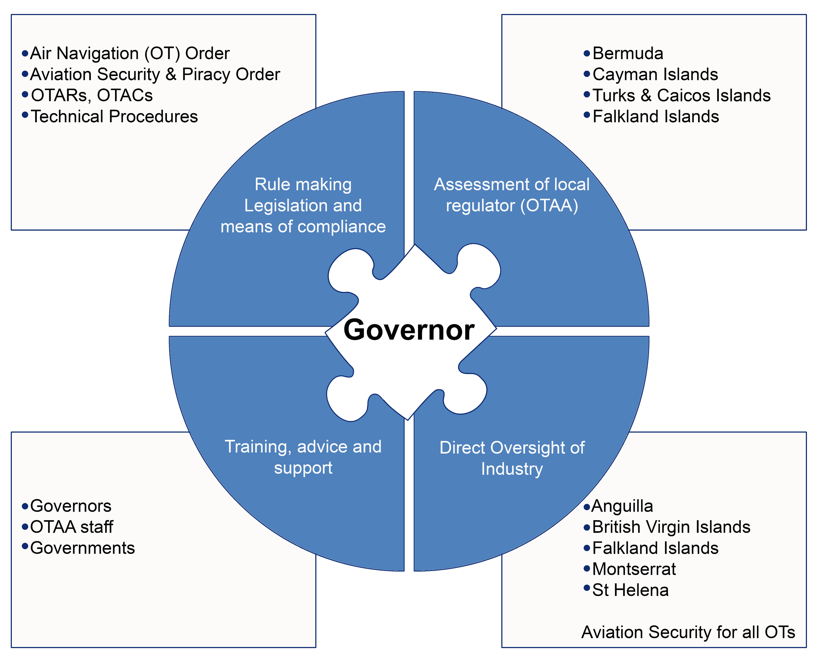
ASSI’s Remit Directions from UK SoS to CAA
Notes:
ASSI were formed on 1 April 2003 via a Direction from the Secretary of State to the UK CAA, our parent company. The diagram above shows our remit and you can see that it speaks to the issues raised by ICAO in 2000.
Go through the diagram. Points:
In 2000 all OTs had their own regulator. By 2003 this was not the case as some of these regulators had retired etc and there was no succession plan in place. ASSI has therefore become the regulator for aviation safety in some OTs and for aviation security in all OTs.
Rule making –Overseas Territories Aviation Requirements (OTARs), Overseas Territories Aviation Circular (OTAC)
Assessment – we have a role to assess the local regulators where they exist. We refer to these entities by the generic term Overseas Territories Aviation Authorities (OTAAs). CI, Bermuda, TCI and FI (see next slide) all have an OTAA. The purpose of the Assessment is to ensure that the OTAAs are doing their job properly and in line with ICAO. The results of the process feed into the Designations. If we have serious concerns about the competency/effectiveness of an OTAA we may recommend to the Governor a change of Designation from the OTAA to ASSI.
Governor – at the centre of the legislation. However, the Gov designates a competent entity to do the work on their behalf i.e. either ASSI or a local regulator for each technical area – see how this split applies to the Falkland Islands on the next slide.

Slide 6
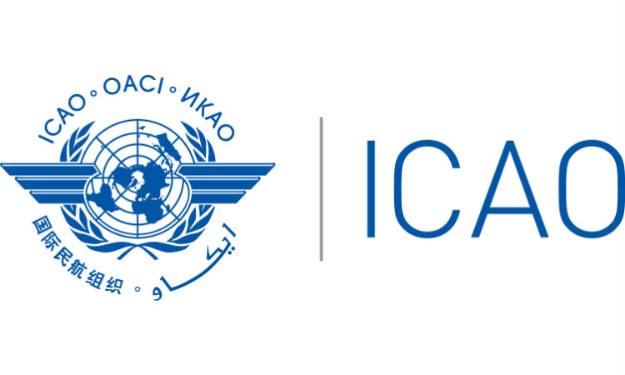
Regulating the Aviation System
19 Annexes to the Chicago Convention
1 Personnel Licensing
2 Rules of the Air
3 Meteorology
4 Aeronautical Charts
5 Units of Measurement
6 Operation of Aircraft
7 Registration of Aircraft
8 Airworthiness
9 Facilitation
10 Aeronautical Telecoms
11 Air Traffic Services
12 Search and Rescue
13 Aircraft Accident & Incident Investigation
14 Aerodromes
15 Aeronautical Information Services
16 Noise and Environmental
17 Security
18 Dangerous Goods
19 Safety Management
Notes:
Just pick out a few of these to describe how the aviation system works ie it is a ‘closed’ system until you prove that you are capable, competent, following the rules etc then you will be given a licence, certificate, permission etc to operate. Thereafter, you need to continue to prove you meet the requirements. This is where the regulator comes in to check. Given the wide range of activities to cover, aviation regulation is expensive because even if a country only has one airport and one small airline, all of the annexes have to be considered and checked for compliance. Just note that Annex 9 is the responsibility of the DfT rather than ASSI. This annex deals with customs, border control, health issues etc. If you require any information on these aspects we can put you in touch with the relevant DfT contacts.

Slide 7


ASSI Relationship with UK CAA
Wholly owned subsidiary
Objectives set by CAA for ASSI (based upon the Directions)
CAA support – HR, Finance, IT, Procurement etc
ASSI Board – inc. CAA, FCDO, DfT
CAA required to audit ASSI activities annually – report to Secretary of State
CAA has no legal powers in the OTs and cannot undertake ASSI's role.
Notes:
Main points: There are strict governance controls in place for ASSI. As a subsidiary of the UK CAA, we are required to use CAA corporate functions eg finance, HR etc. However, we have our own Board of Directors which includes a Director from DfT and FCDO as well as a Director from the CAA. We have an independent Chair.
The CAA is required through the Directions to audit ASSI annually – this is in a technical area – and we are part of the CAA’s internal audit process. The reports on these audits go to the SoS (thru the DfT).

Slide 8
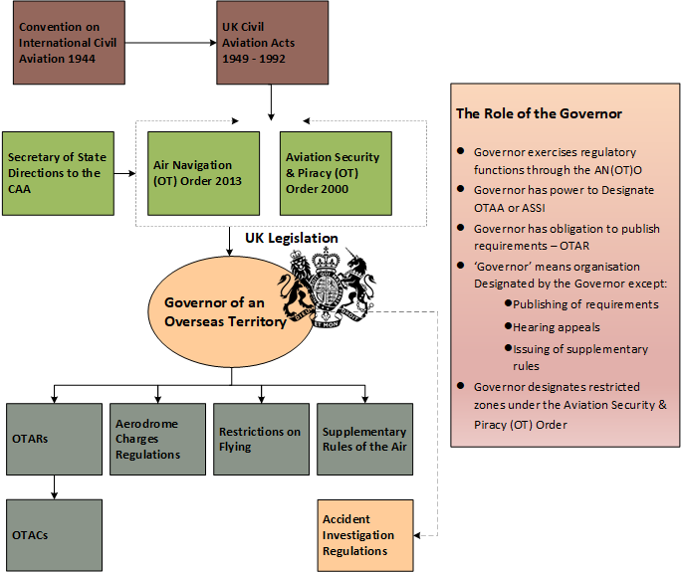
Notes:
The legal system created for ASSI has been tested several times since the initial scathing audit by ICAO in 2000 and has been found to be robust and cohesive. The most recent audit by ICAO of Bermuda in 2019, resulted in 100% in the area of legislation.
This is how it hangs together:
The ICAO (Chicago) Convention is given effect through the primary legislation ie the various UK Civil Aviation Acts. These in turn, flow through to the secondary legislation – two Orders, one for safety and one for security in the OTs. You will see that the Directions which formed ASSI are given effect by the secondary legislation.
As previously mentioned, the Governor is at the centre of the secondary legislation. For example, if someone wants to apply for a certificate, licence etc the law says that the Governor must be satisfied that the applicant meets all the requirements. Through the Designation Instrument, this means that the Designated entity must be satisfied ie ASSI or the local CAA, rather than the Governor. The Governor should remain hands-off because there are certain things within the AN(OT)O that the Governor is not permitted to delegate to the Designated entity. One of these is the hearing of appeals in the event that the regulator revokes or refuses to issue an approval/licence for example. The Governor must therefore remain as impartial as possible.
There are other exceptions where the ‘Governor’ means the actual Governor – publishing of requirements ie the OTARs. We write these but the Governor must arrange for these to be gazetted in the OT. (these have all been gazetted in all OTs). Likewise there may be a need for restrictions on flying – again the Governor would have to issue these although we would draft them. (you may want to give examples of when restrictions may be needed etc)
You may notice the reference to Air Accident Investigation Regulations. The Air Accident Investigation Branch (AAIB) is the accident investigation body for all OTs. AAIB is based in Farnborough. They will support in the event of an aircraft accident or serious incident occurring in an OT, including within territorial waters. They also provide training in the OTs every few years. It is worth having a briefing with them before posting. Ndann@aaib.gov.uk
Further information on the Aviation Law and Regulation in the OTs ASSI publishes an Information Paper (IP62 issue 5.00 18/4/2025) – ASSI will send a copy with this slide deck. ASSI also has self-paced training on Air Law available through our Learning Management System (LMS) and access is available for Governors and staff in your Office. Further information on this is available via the ASSI Training Manager – clare.bury@airsafety.aero.

Slide 9
ASSI - Rulemaking and Policy
Civil Aviation in the UK Overseas Territories is governed by legislation (principally the Air Navigation (Overseas Territories) Order (AN(OT)O) and International Conventions and Standards (principally those published by the International Civil Aviation Organisation) with which the UK, as a State, has agreed to comply.
The Civil Aviation Overseas Territories Act 1949 (as extended to the Overseas Territories) enables the Governor of each Territory to exercise his/her regulatory obligations, either directly or through a Designated person or organisation.
ASSI has published and maintains 32 Overseas Territories Aviation Requirements (OTAR) on behalf of Governors of the Overseas Territories in support of the Governor’s powers contained in the AN(OT)O. These are legally binding in each of the Territories and are prepared by ASSI and agreed by the Governors. OTAR are designed to ensure that adequate levels of safety are met which comply with the Annexes to the Chicago Convention (Standards and Recommended Practices).

Slide 10
ASSI - Rulemaking and Policy Cont.
Overseas Territories Aviation Circulars (OTAC): are designed to complement the OTARs by providing additional information and guidance on how to meet the requirements. They also provide a means of communicating with the aviation industry on regulatory matters more generally. ASSI publishes and maintains 81 OTAC documents which relate to OTAR.
ASSI policies are intended for the use and guidance of regulatory staff of the Territories and for the staff of ASSI. Currently 27 such documents have been published and maintained, controlling the process of regulation in the Territories and are equally applicable throughout the Territories.
ASSI has undertaken to provide stakeholders with advance notification of impending changes to OTARs by means of Overseas Territories Aviation Notice(s) of Proposed Amendment.
The regulator designated for the Overseas Territories may grant an Exemption against specific provisions of the Air Navigation (Overseas Territories) Order. An applicant for an Exemption should provide an appropriate risk assessment relevant to the situation for which the Exemption is sought.
Similarly, the designated regulator may also grant Deviations against specific OTAR provisions subject to a similar risk assessment process.

Slide 11
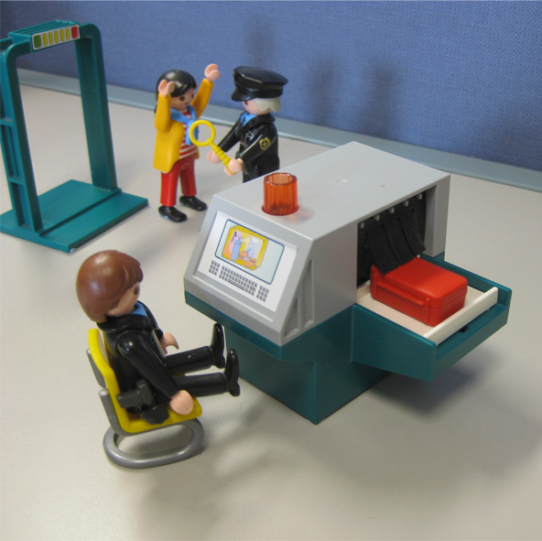
Regulation of Aviation Security
Transferred from UK Government to ASSI on 1 April 2015
OT Governor chairs the National Civil Aviation Security Committee (NCASC)
The NCASC is responsible for ensuring that security provisions are adequate for the OTs particular circumstances/risks
Membership includes customs, border force, police, aviation industry etc
Any additional measures are captured within the National Civil Aviation Security Programme (NCASP)
Notes:
Main points:
Originally not within our remit. We took over responsibility from DfT in 2015
DfT funds reg oversight of this area – no charging to OTs…as yet!
This area will probably bring you closer to ASSI than the safety area as we will support the National Civil Aviation Security Committee (NCASC) (for Tier 1) which meets twice per year and is chaired by the Governor
The NCASC is an important meeting that brings together all the relevant agencies in the Territory that have an interest in security. While we have said that ICAO sets the minimum standards to be met through the SARPs, a Territory may need additional measures due to the local situation in the Territory. This committee discusses local intelligence and then agrees what additional measures, if any, should be in place. These are then captured in the NCASP.
The National Civil Aviation Quality Control Programme (NCAQCP) sets out how ASSI does oversight eg frequency of audits etc
The National Civil Aviation Training Programme (NCATP) sets out the requirements for initial and continuation training for Aviation Staff in the Territories.

Slide 12
Notes:
So how do we encourage compliance with ICAO SARPs? Through auditing and following up on findings. This diagram shows the escalation process if industry fails to address any issues raised.

Slide 13
Accident investigation and the role of ASSI
The International Standards and Recommended Practices for the investigation of aircraft accidents and incidents are contained in Annex 13 to the Convention on International Civil Aviation.
Under the UK Civil Aviation Action 1982 as extended to the Territories, Governors are required to make regulations for the investigation of air accidents in their respective Territories.
The UK Air Accidents Investigation Branch (AAIB) investigates civil aircraft accidents and serious incidents within the UK, its overseas territories and crown dependencies and are responsible for ensuring the Governor complies with their international obligations. The AAIB is independent of ASSI.
In parallel to the AAIB investigation the Police and other authorities may also be conducting criminal investigations and in some cases, the designated regulator may be seeking to establish whether regulatory enforcement action is necessary.
All interested parties must work collaboratively to ensure just culture principles are upheld and natural justice can be maintained.

Slide 14
Matthew Bennett – Senior Legal Adviser matthew.bennett@caa.co.uk

