Slide 1
THE CHALLENGE OF CARIBBEAN CONNECTIVITY
Rafael Echevarne
Director General

Slide 2
Airports Council International - ACI
International Association of Airports
Official voice of the Airport Industry in ICAO
Globally > 2,100 member airports
Caribbean and Latin America > 300 airports

Slide 3







ADVOCACY on GLOBAL PRIORITIES
Safety & Technical
Environment
Economics
Facilitation
& Services
Airport Security
Airport IT
Airport Slots

Slide 4
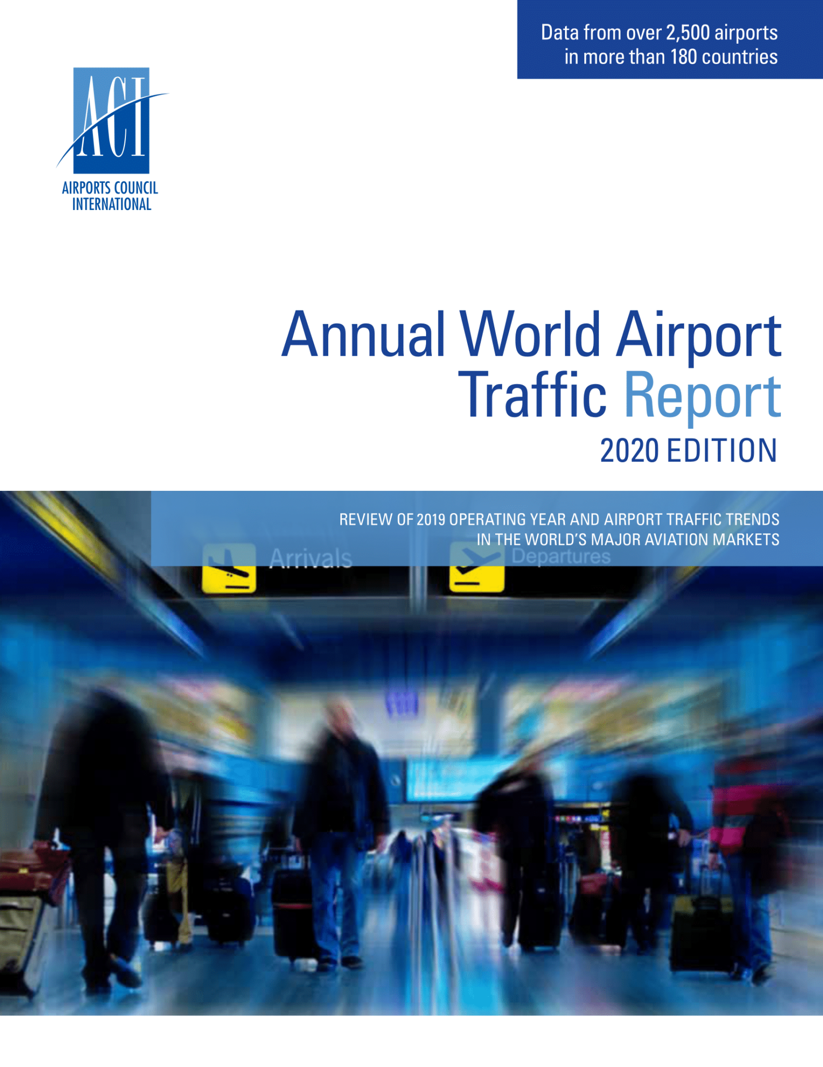
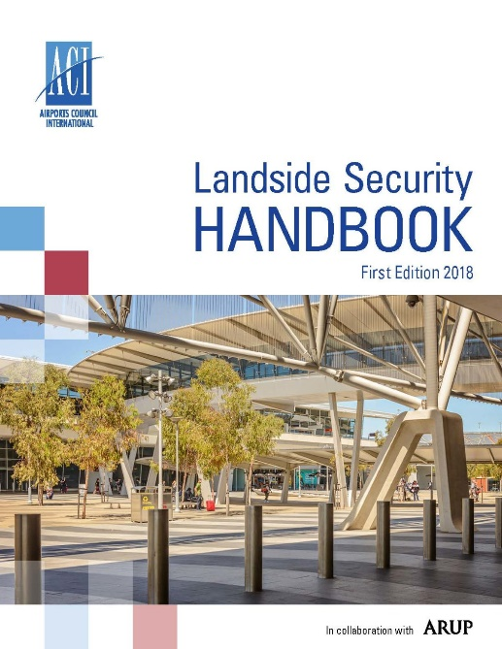
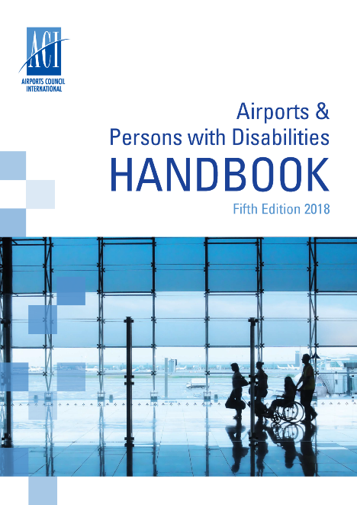

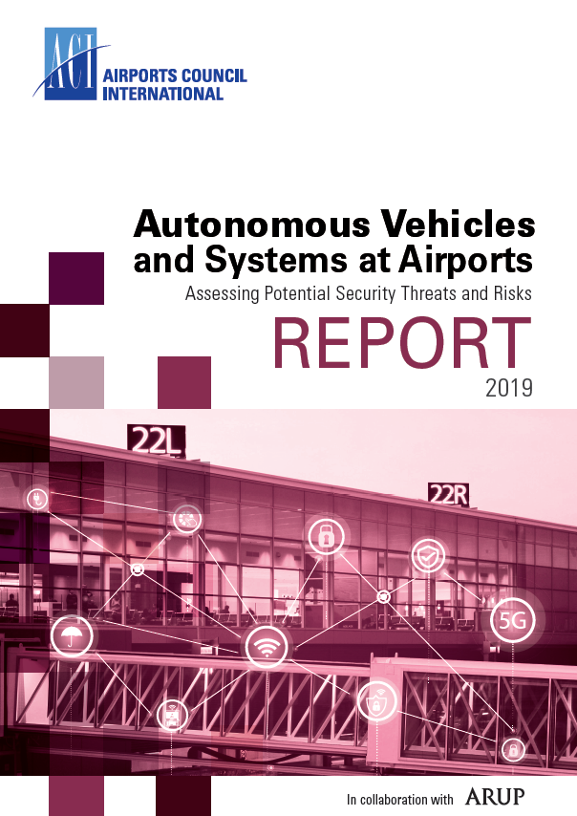

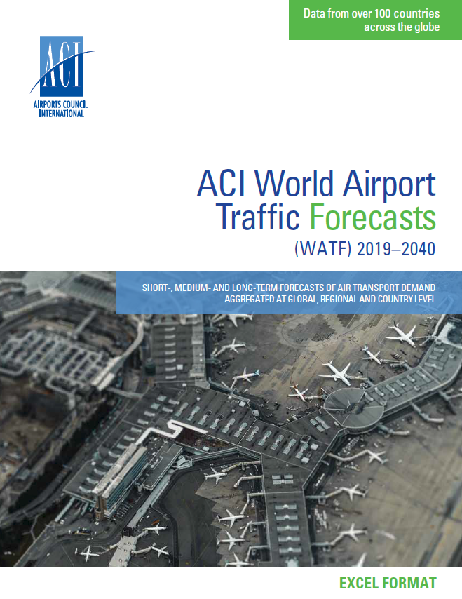
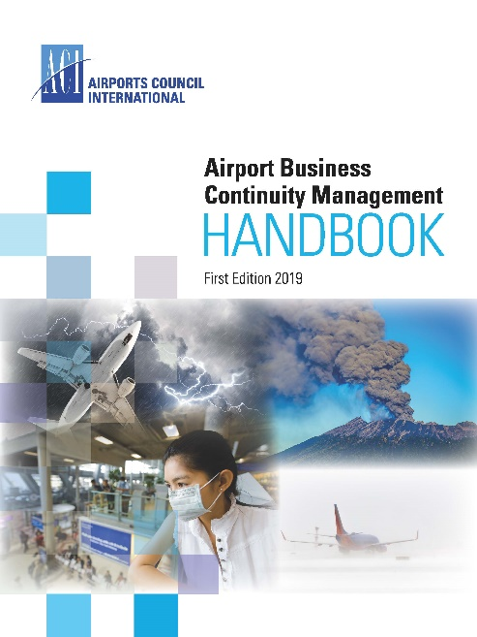
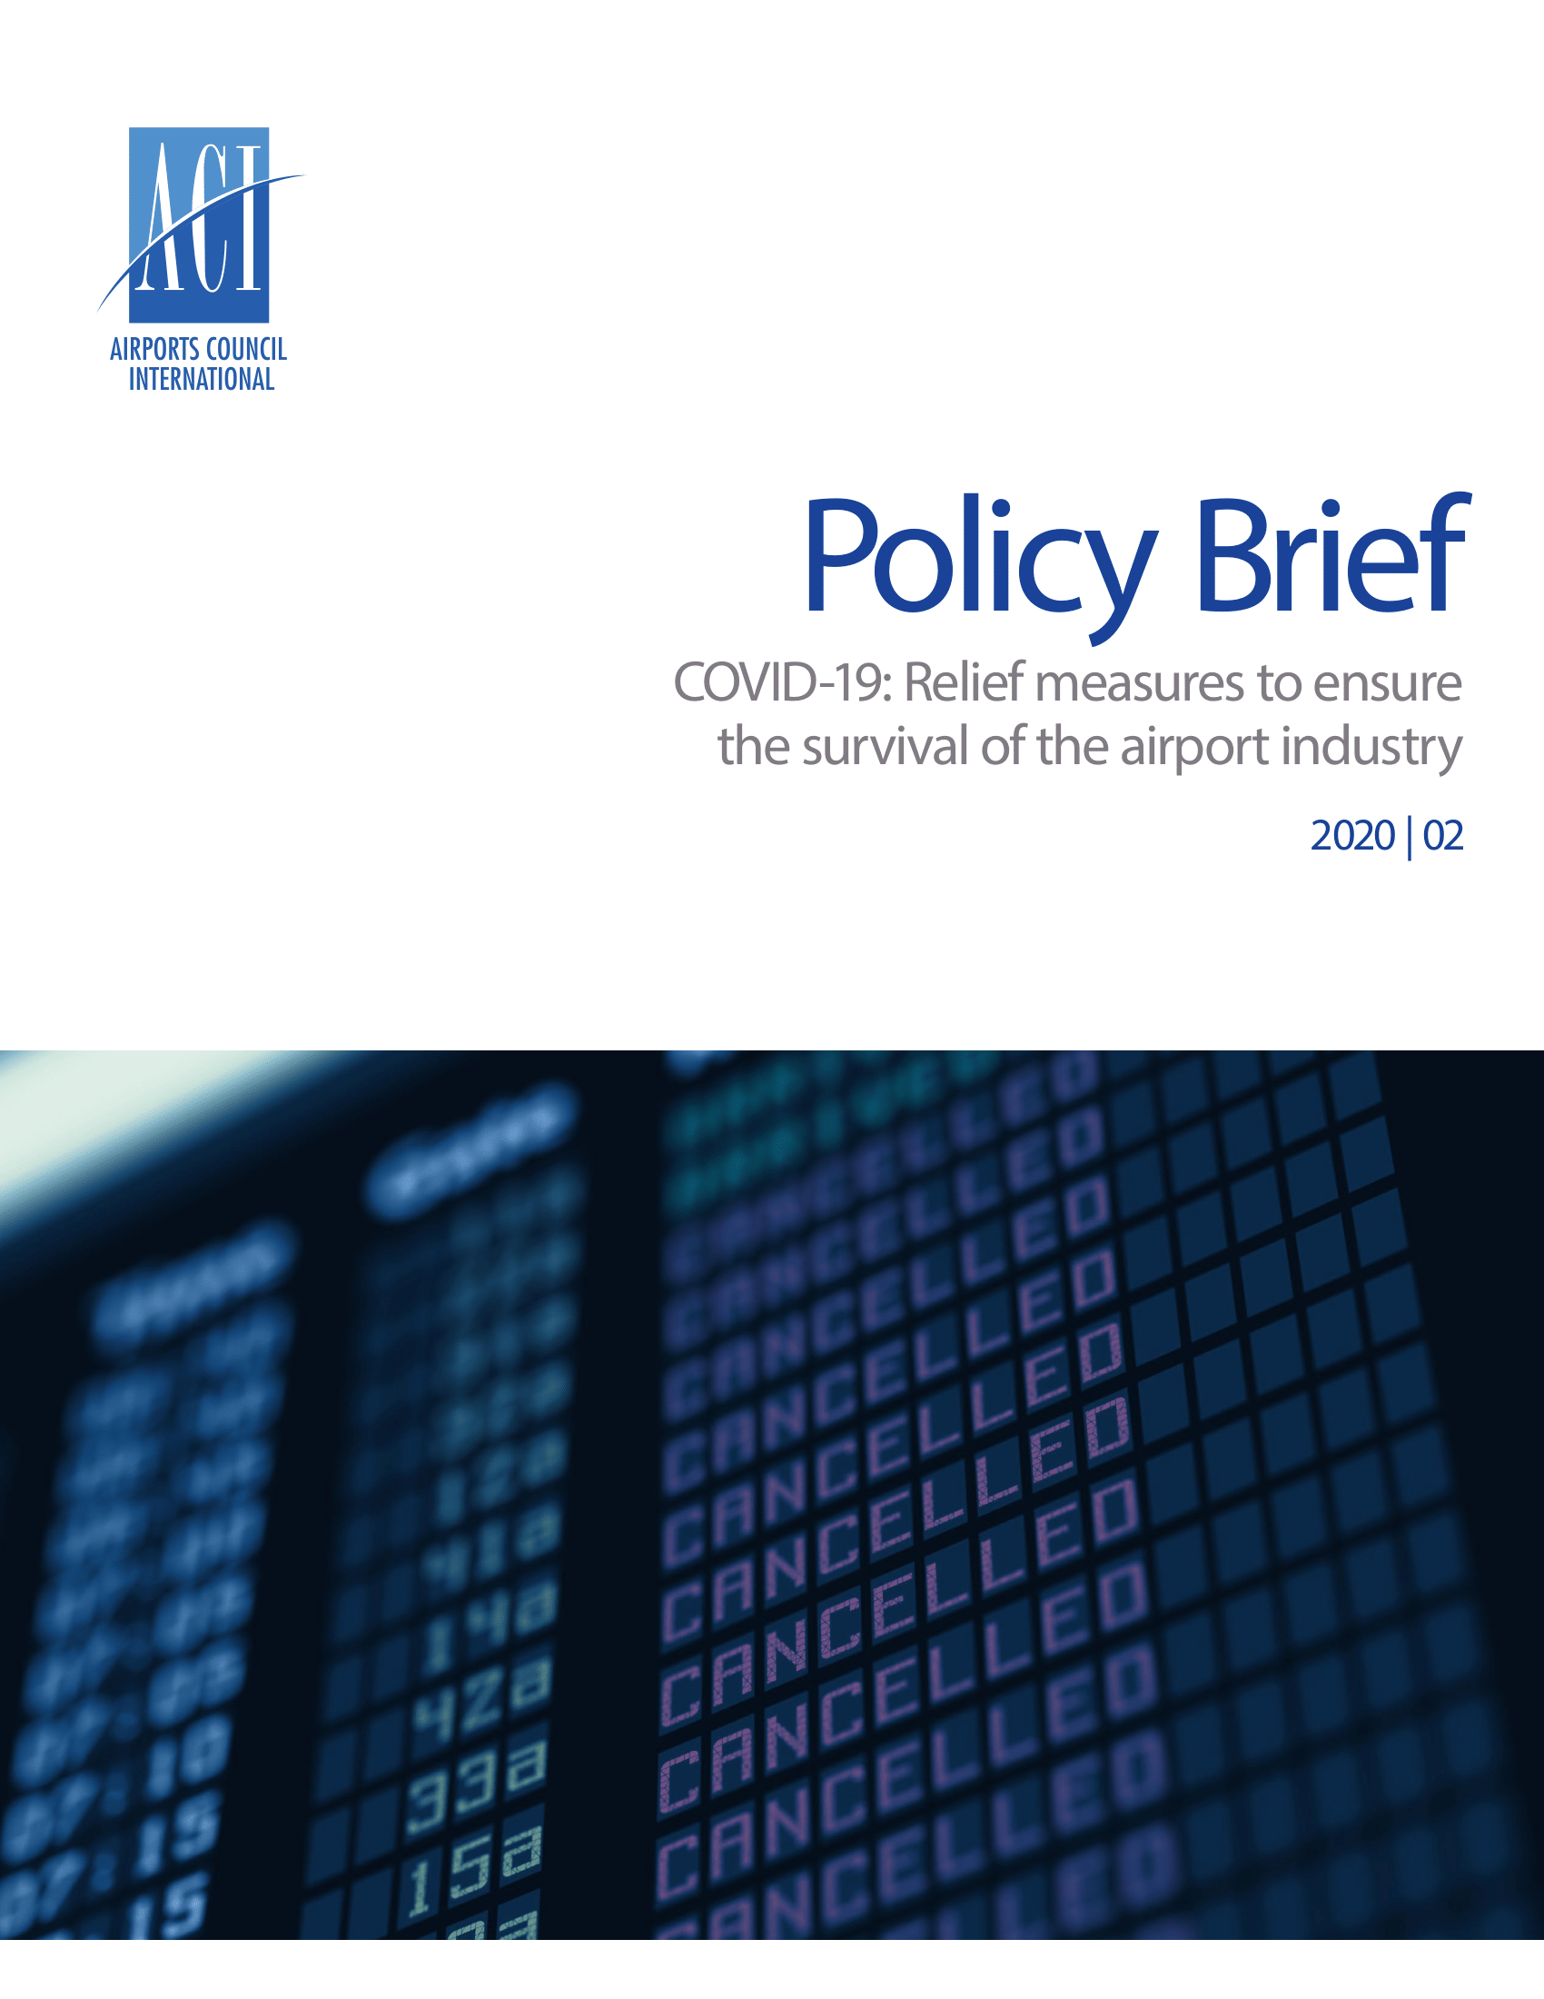
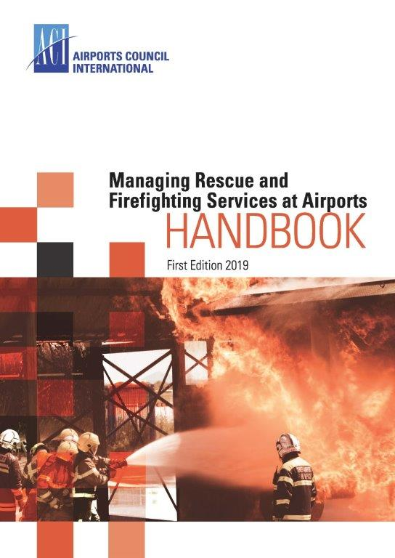
PROMOTING AIRPORT EXCELLENCE – Focus on Safety and Operations

Slide 5



APEX in SAFETY
ACI and ICAO launched APEX in Safety programme in 2012: has since completed more than 150 Reviews
APEX in Security followed in 2017
The programme is a peer-to-peer review, providing access to a global network of expertise with support, training and mentoring
Compliance with ICAO SARPs and ACI best practice
APEX in Environment piloted in 2018 to assist members meet ACI best practices and is being designed as a voluntary peer review process
Virtual APEX offerings are being developed

Slide 6
Virtual APEX programs
Virtual APEX provides a peer-to-peer 100% online review
Launched in July 2020
Available Virtual Reviews:
Safety Management System (SMS) 3-5 days
Aerodrome Manual 2-4 days
Wildlife Hazard Management 3-4 days
Airport Security Programme 3-5 days
Risk Management Programme 2-3days
Checkpoint screening 2-3 days
More…..
Visit our website at https://aci.aero/apex/virtual-apex-solution/

Slide 7
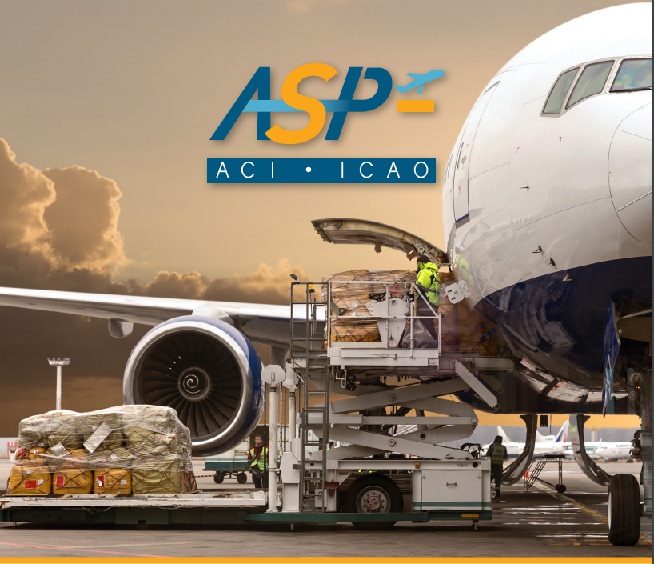


Global ACI-ICAO
Airport Safety Professional (ASP) designation programme
The ASP designation aims to recognize the professional requirements of both the State regulators in demonstrating their proficient knowledge of relevant ICAO SARPs, and airport operations’ managers in applying their professional expertise within their field.
Notes:
Hot off the press – Launched just last week.
Jointly offered with ICAO, This new accreditation programme builds training capacity in the key area of Safety while enhancing airport excellence and industry best practices in compliance with ICAO SARPs, and is the second accreditation jointly offered by both organizations; AMPAP was the first.
Programme structure – 3 mandatory and 1 elective. Plus final ASP validation exam.
Elective requirement is waived, if the participant is a ACI Global Safety Network (GSN) Diploma Programme graduate (Initial or Advanced) or has successfully completed the ICAO State Safety Programme (SSP).
Successful candidates will be awarded with the professional designation of ASP (airport safety professional) valid for 3 years.
Candidates who have already taken the courses in 2018 will be credited towards the ASP programme.
NOTE: Congratulations to ANAC Brazil for being the launch customer to commence the ASP programme. They were the first to receive the first virtual deliveries of the ACI-ICAO Implementing Annex 14 course (Oct 19-23), and the ACI-ICAO Aerodrome Certification course (Nov 9-13)

Slide 8


x
ASP Programme Objectives
The goal of this Programme is to:
Accredit individuals as having acquired the knowledge and expertise to ensure the highest operational levels of safety at the airport;
Recognize professional excellence in airport airside management;
Increase professional knowledge and capability in the airport industry;
Promote the adherence to uniform standards and recommended practices and awareness of best practices;
Support the qualification requirements for ACI APEX safety assessors and ICAO USOAP assessors;
Expand communication and networking among airport safety executives and regulators globally

Slide 9

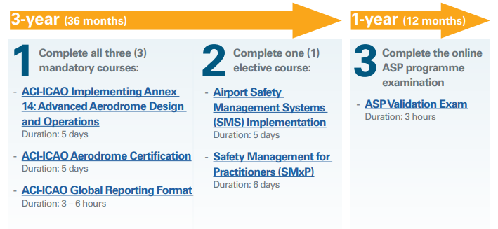
ASP Programme Structure
To successfully complete the programme and obtain the ASP professional designation, candidates must:
Visit the ASP webpage for more information.
Notes:
Hot off the press – Launched just last week.
Jointly offered with ICAO, This new accreditation programme builds training capacity in the key area of Safety while enhancing airport excellence and industry best practices in compliance with ICAO SARPs, and is the second accreditation jointly offered by both organizations; AMPAP was the first.
Programme structure – 3 mandatory and 1 elective. Plus final ASP validation exam.
Elective requirement is waived, if the participant is a ACI Global Safety Network (GSN) Diploma Programme graduate (Initial or Advanced) or has successfully completed the ICAO State Safety Programme (SSP).
Successful candidates will be awarded with the professional designation of ASP (airport safety professional) valid for 3 years.
Candidates who have already taken the courses in 2018 will be credited towards the ASP programme.
NOTE: Congratulations to ANAC Brazil for being the launch customer to commence the ASP programme. They were the first to receive the first virtual deliveries of the ACI-ICAO Implementing Annex 14 course (Oct 19-23), and the ACI-ICAO Aerodrome Certification course (Nov 9-13)

Slide 10
LIBERALIZATION & DEREGULATION
Open & Unrestricted Access
Proven Success Worldwide
Institutional Readiness for Openness

Slide 11
STRATEGIC IMPORTANCE OF AIR CONNECTIVITY
Air transport supports up to 8.7% of employment and 12.8% of GDP in small island states.
Tourism contributes over 10% of GDP in nearly all Caribbean islands; up to 83% in Antigua & Barbuda.
Air connectivity is vital for economic competitiveness and regional integration.

Slide 12
DUAL REALITIES OF CARIBBEAN CONNECTIVITY
Extra-Caribbean seat capacity grew +2.8% CAGR (2010–2024); now 85% of total.
Intra-Caribbean capacity declined nearly 50% over the same period.
Intra-regional connectivity index fell 30%, especially in Eastern Caribbean.

Slide 13
BARRIERS TO INTRA-CARIBBEAN TRAVEL
Fragmented markets and small-scale demand.
Limited airport anchors and weak inter-island networks.
High travel costs, low frequencies, and inconvenient itineraries.
Decline in city pairs and weekly flights over two decades

Slide 14
POLICY AND REGULATORY CHALLENGES
Unilateral government actions without industry consultation.
Burdensome regulations and non-aviation taxes.
Fragmented visa, entry, and airport security protocols.
Lengthy permit processes and lack of multimodal vision.

Slide 15
MARKET AND COST PRESSURES
Intra-Caribbean airfares and hotel costs are disproportionately high.
Average Daily Rates for Caribbean hotels: $437 USD vs. $273 USD (U.S.) and €243 (Southern Europe).
Local incomes often insufficient to support regional travel

Slide 16
RECOMMENDATION 1 – BILATERAL FIRST
Prioritize bilateral commercial opportunities over aspirational regional schemes.
Focus on tangible, demand-driven partnerships.
Use multilateral platforms for dialogue, not dependency.

Slide 17
RECOMMENDATION 2 – REGULATORY CONVERGENCE
Aim for alignment on key issues (e.g., visas, security) rather than full harmonization.
Leverage CARICOM MASA’s “Community of Interest” principle.
Select 1–2 priority areas for immediate convergence.

Slide 18

ADDITIONAL RECOMMENDATIONS
Implement regional incentive schemes for route development and resident travel.
Reduce total travel costs with a “journey vision” (airfare, layovers, taxes).
Move from “paper liberalization” to effective, business-friendly regulation.

Slide 19

A RENEWED VISION FOR PROGRESS
Intra-Caribbean connectivity must be treated as a strategic priority.
Success depends on political will, targeted investment, and industry collaboration.
ACI-LAC will continue to work on advocacy, fostering partnerships, and data-driven action.

