Slide 1
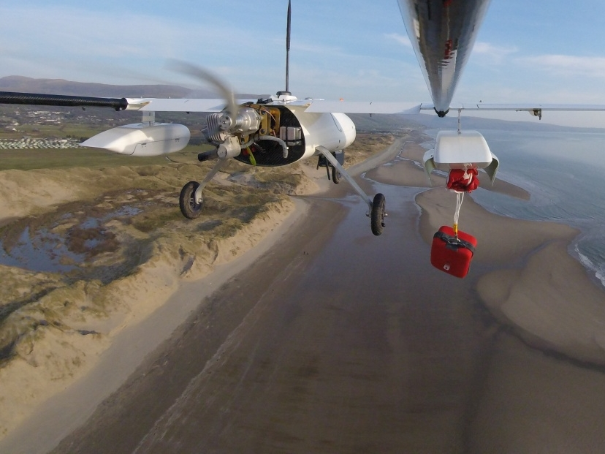

UAS/DRONE OPERATIONS
The challenges of BVLOS and
Safe airspace integration

Slide 2
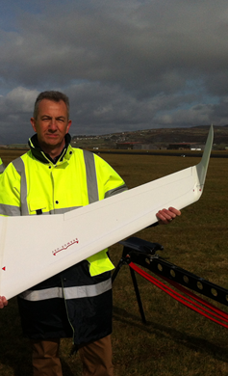
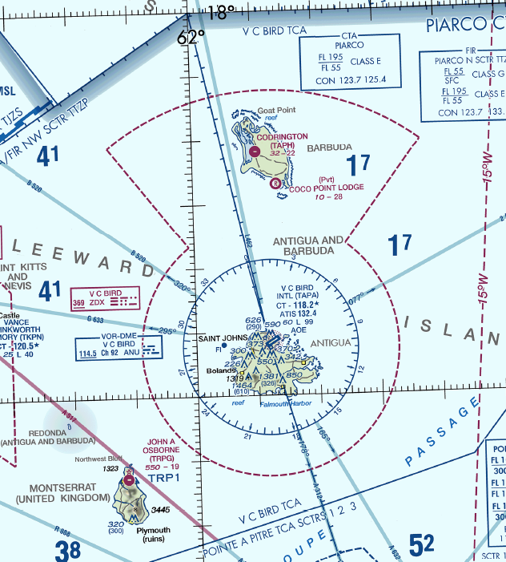
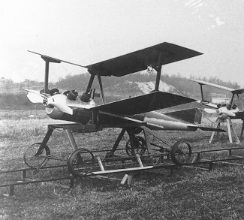
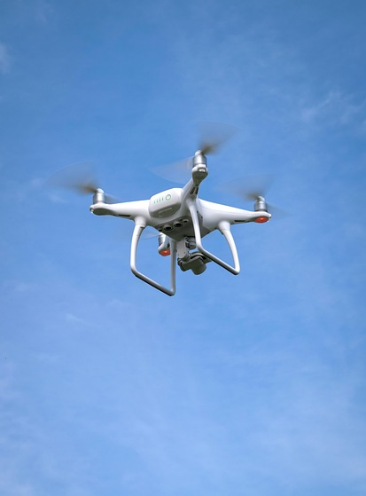
DRONES – THE CHALLENGES
What we’re going to cover
What is a UAS?
Liable, Responsible, Accountable or Unaware?
Why are they such a problem?
SORA
NIGEL BREYLEY FRAeS

Slide 3
DRONES – THE CHALLENGES
Some scene setting
Who is liable?
If the aircraft is autonomous, who is legally responsible/accountable/liable - Pilot in command? The software writer or Accountable Manager?
Freedoms - Rights between countries and where the company is registered
No greater threat than manned aviation (who to?) - Acceptable level of safety – Target Levels of Safety 1 x 10 minus something?
FAA Part 108 The pilot acting as a “Network Manager” responsible for monitoring multiple aircraft flying simultaneously. The Operator is responsible/accountable
Pilot in a different country. In the loop. On the loop and Autonomy & AI
Manufacturers role in accident investigations.
Trespass and Privacy
Notes:
Standards and Certification is largely missing and many Sates don’t have reciprocal arrangements for airworthiness and have different mechanisms to assure them
What is an acceptable level of safety – Target levels of Safety 1 x 10 minus something probability
Nobody on board during the crash
Operators and many manufacturers have no aviation pedigree
Royal Navy versus RAF – use SKW what you can and can’t do and regulators being over prescriptive when they don’t know what they’re regulating
ICAO Model rules don’t fit all circumstances and all countries and require resources which many states don’t have available.
It’s called unmanned but we discuss keeping people In the loop. On the loop and are more frequently handing over management of the flight to autonomy & AI
So the question is who is the pilot in command and where do liabilities lie.
Let’s try and determine what is a UAS

Slide 4
WHAT IS A UAS?
01

Slide 5
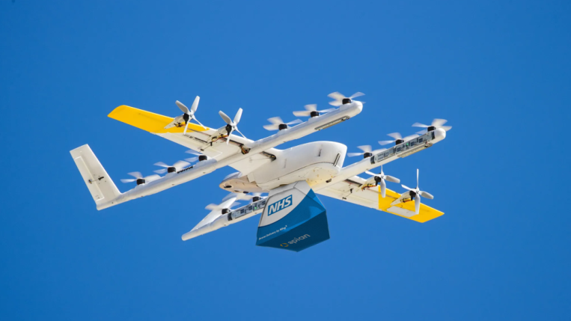
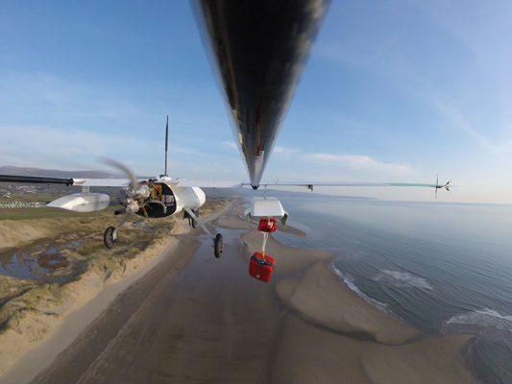
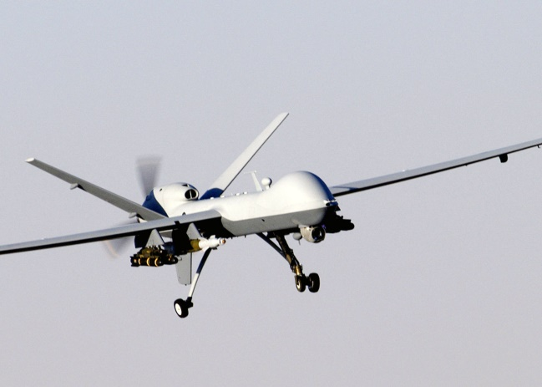
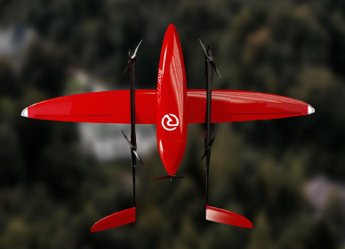
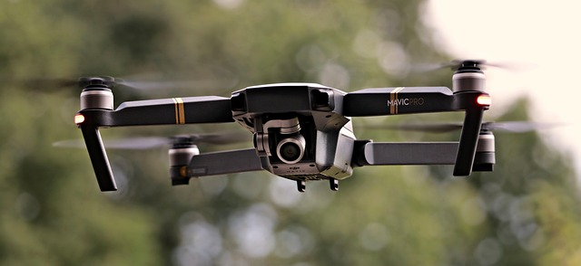
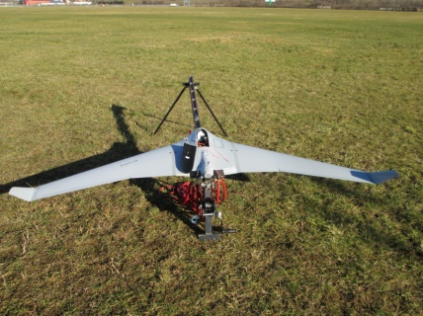
DRONES – THE CHALLENGES
What is a UAS?

Slide 6

DRONES – THE CHALLENGES
What is a UAS?
Aircraft. Any machine that can derive support in the atmosphere from the reactions of the air other than the reactions of the air against the earth’s surface.
Unmanned aircraft. An aircraft which is intended to operate with no pilot on board
Autonomous aircraft. An unmanned aircraft that does not allow pilot intervention in the management of the flight.
Remotely piloted aircraft. An unmanned aircraft which is piloted from a remote pilot station.
Remotely-piloted aircraft. An aircraft where the flying pilot is not on board the aircraft. Note.— This is a subcategory of unmanned aircraft.

Slide 7


DRONES – THE CHALLENGES
What is a UAS?
An unmanned aircraft system is an unmanned aircraft and the equipment necessary for the safe and efficient operation of that aircraft. An unmanned aircraft is a component of a UAS. It is defined by statute as an aircraft that is operated without the possibility of direct human intervention from within or on the aircraft (Public Law 112-95, Section 331(8)).
For the purposes of this Regulation, the following definitions apply:
(1) ‘unmanned aircraft’ (‘UA’) means any aircraft operating or designed to operate autonomously or to be piloted remotely without a pilot on board;

Slide 8
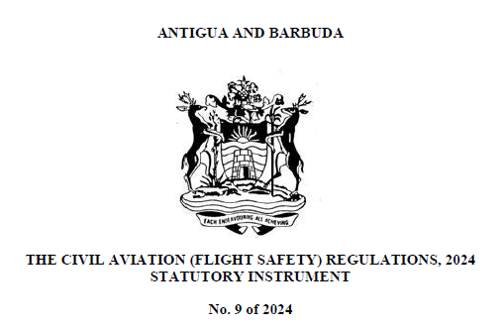
DRONES – THE CHALLENGES
No. 9 of 2024 134 The Civil Aviation (Flight Safety) Regulations, 2024
(641) “Unit load device” means any type of aircraft container, aircraft pallet with a net, or aircraft pallet with a net over an igloo;
?????????????????????
(642) “Unmanned free balloon” means a non-power-driven, unmanned, lighter-than-air aircraft in free flight;
(505) “Remotely piloted aircraft (RPA) ” means an unmanned aircraft that is piloted from an RPS;
(506) “Remotely piloted aircraft system (RPAS) ” means an RPA, its associated RPSs, the required C2 links, and any other components as specified in the type design;
(507) “Remote pilot” means a person

Slide 9
RESPONSIBLE ACCOUNTABLE LIABLE OR UNAWARE
02

Slide 10
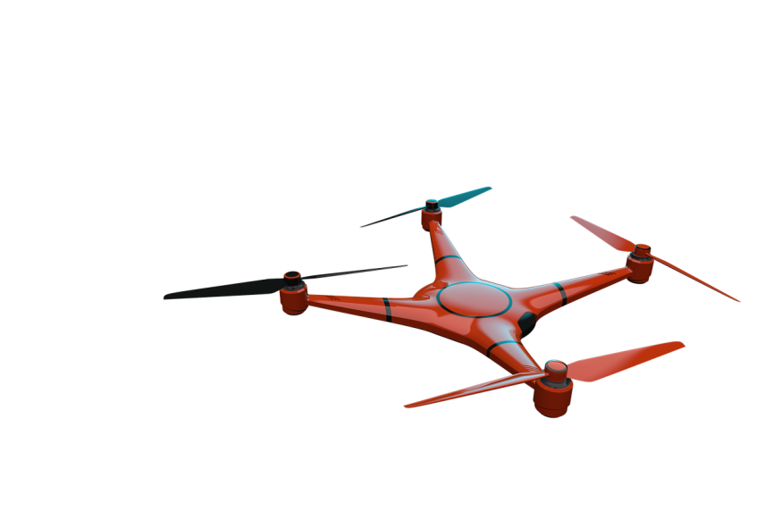
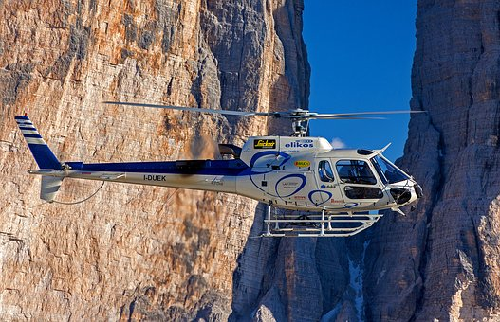
DRONES – THE CHALLENGES
Certification (Quantitative)
Objective - numerical
Safety Case (Qualitative)
Subjective - analytical
Aircraft built to recognised standards
Supplied by DAO
Traceability of components
Failure testing in standardized conditions
No recognised standard
Built by almost anyone
No traceability of components
Lack of testing standards
Firmware, hardware, software updates controlled.
Download anything from anywhere
Judgement versus numbers = fear of liability by regulators

Slide 11
DRONES – THE CHALLENGES
The Court according to Microsoft Co-pilot
Liability = Legal enforceability
Accountability = Answerability (may lead to liability)
Responsibility = Assigned duty (may be moral, ethical, or legal)
According to a study in European Journal of Risk Regulation (2023), liability for injury to persons on the ground lies with
UK The owner, of if hired >14 days the hirer (UK Civil Aviation Act 1982)
Germany “Holder” fault-based liability - could be Pilot or Owner or in some cases manufacturer (negligence/intent/error)
“The controlling mind”

Slide 12
DRONES – THE challenges
The Air Navigation Order 2016
UK Statutory Instruments
2016 No. 765
PART 10
CHAPTER 1
Endangering safety of an aircraft
240.—A person must not recklessly or negligently act in a manner likely to endanger an aircraft, or any person in an aircraft.
Endangering safety of any person or property
241.—A person must not recklessly or negligently cause or permit an aircraft to endanger any person or property.

Slide 13
WHY ARE THEY SUCH A PROBLEM?
03

Slide 14
DRONES – THE CHALLENGES
Human Error & Design
“ ...serious accidents are frequently blamed on human error. Yet careful analysis of such situations shows that the design or installation of the equipment has contributed significantly to the problems”.
Donald Norman - The Design of Everyday Things.
Carelman’s Coffeepot

Slide 15

DRONES – THE CHALLENGES
Recovery required 40kts G/S
Wind 330°/20 kts
Input required Wind 10m per sec/330°
Actual input 330m per sec /10°
Aircraft dived to achieve 640kts
Correct WV: 10330
Actual WV: 33010
What do you think was the cause?

Slide 16
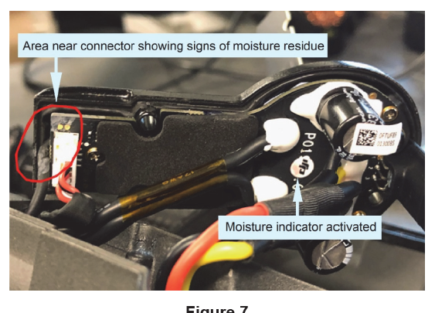
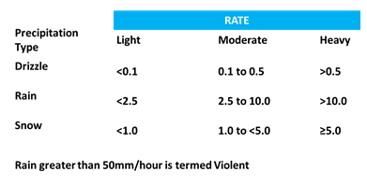

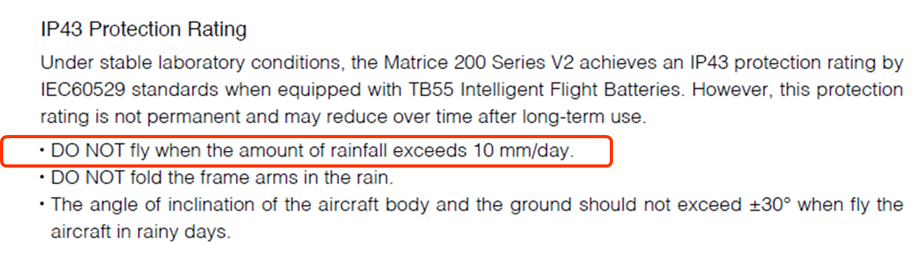
DRONES – THE CHALLENGES
Matrice 210 accident UK
Image from UK AAIB Report
10mm/day – website says 10mm/hour!

Slide 17
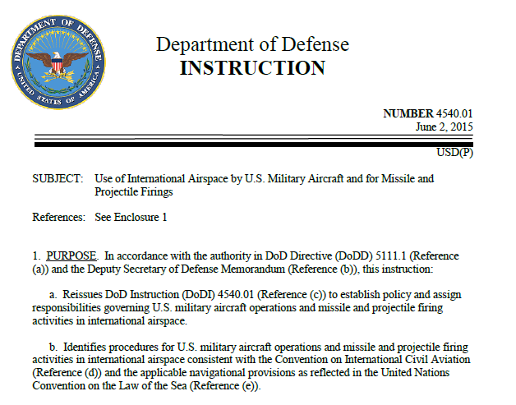

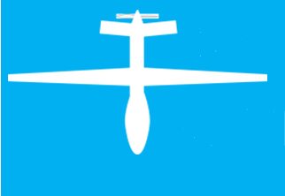
DRONES – THE CHALLENGES
Due Regard ICAO High Seas
Due Regard Operations
BVLoS
Public Interest/National Security – other benefits outweigh the risks – Would a Predator be allowed to fly over London for example in some circumstances?
Notes:
Due Regard is a concept used by the military in International Airspace where there is no radar cover and separation cannot be guaranteed
Used for State aircraft.

Slide 18

DRONES – THE CHALLENGES
Detect and Avoid/Sense and Avoid – What is acceptable
NMAC
Near Miss Air Collision
RWCB
Remain well clear boundary
DV
Detection Volume
Dimensions depend upon relative closing speeds and sensor performance
+/- 100ft
500ft lateral
+/- 450ft Vertical
2000ft (610 m) Horizontal
UK: Airprox
Parameter-less
Distance or time?
(Closing speed)

Slide 19
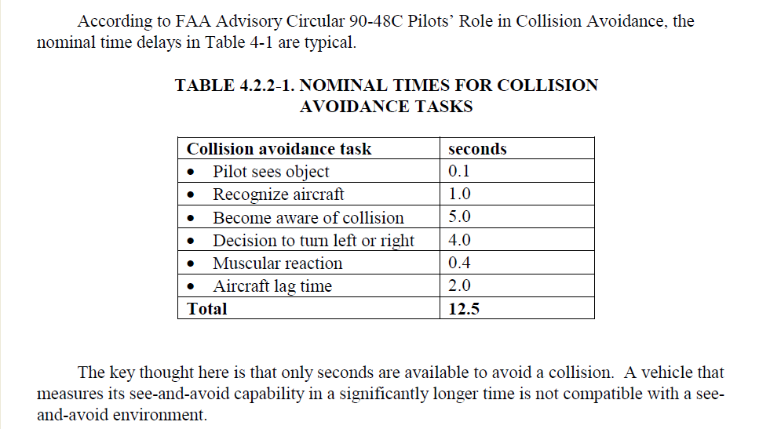
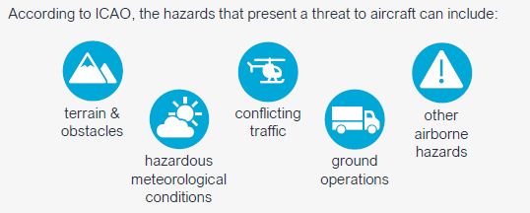
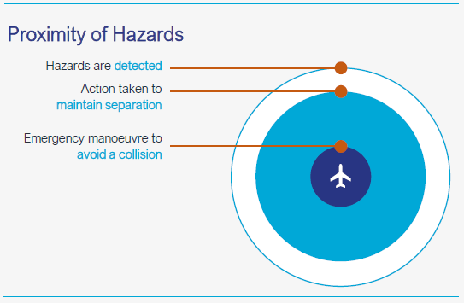
DRONES – THE challenges
Cooperative
Non-cooperative
ADS-B
Remote ID
Images from UK CAA

Slide 20
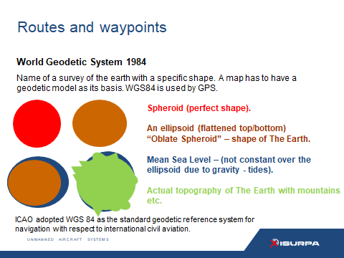
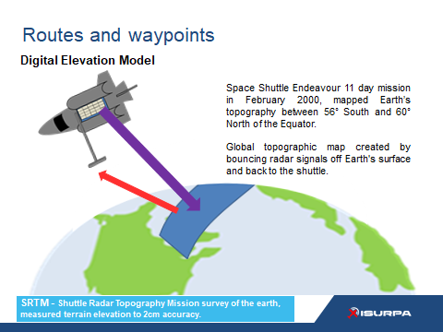
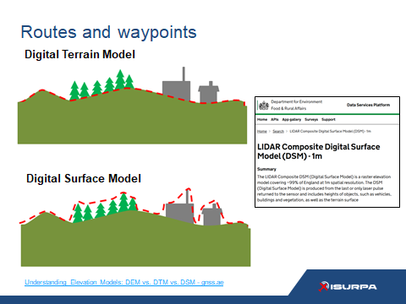
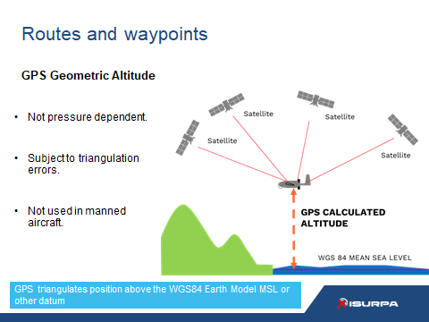
DRONES – THE CHALLENGES
Altitude/Height or something else?
QFE
QNH
RPS
SPS
GNSS
Barometric or Geodetic

Slide 21
SORA SPECIFIC OPERATIONS RISK ASSESSMENT
04

Slide 22
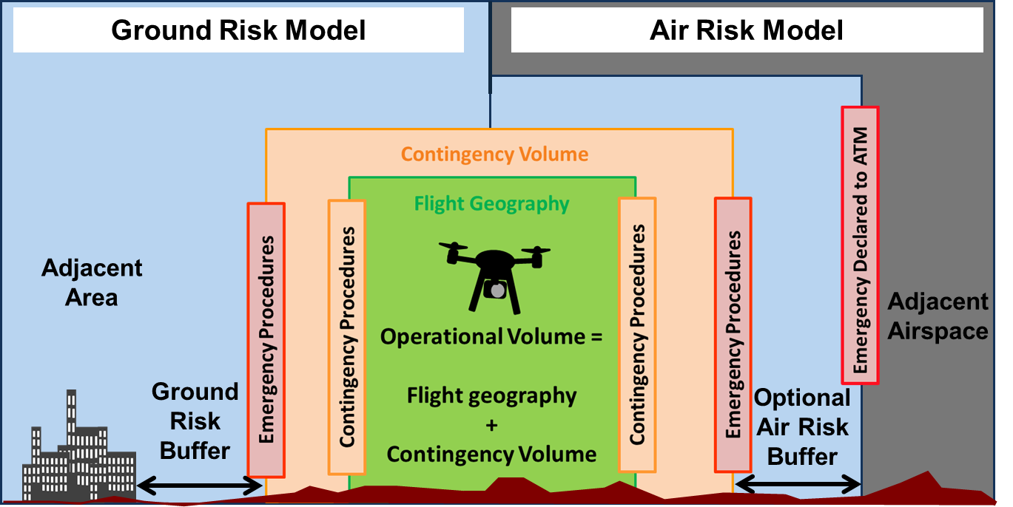
Low
Medium
High
DRONES – THE CHALLENGES
AUTOMATION
Operational Volume includes:
“Flight Geography” (the UA flight path under normal operations) and the
“Contingency Volume” (the projected UA flight path under abnormal conditions handled through contingency procedures.
An out of control operation means that the UA is flying outside this operational volume – potentially leading to harm to third parties either in the air or on the ground.
Notes:
Provides guidance to NAA and the Operator (applicant)
about what is required to fly a UAS in a given
operational environment.
Operational Volume includes:
The SORA works on the basis of classifying the air risk and ground risk and then ensuring sufficient mitigations are applied to make the risks acceptable. The mitigations have to meet certain levels of robustness (effectiveness and Reliability) dictated by the applicable OSOs - Operational Safety Objectives such as Ensure that the Operator is competent, UAS is manufactured by competent and/or proven entity and the C2 link performance is appropriate for the operation
“Flight Geography” (the UA flight path under normal operations) and the
“Contingency Volume” (the projected UA flight path under abnormal conditions handled through contingency procedures.
An out of control operation means that the UA is flying outside this operational volume – potentially leading to harm to third parties either in the air or on the ground.

Slide 23
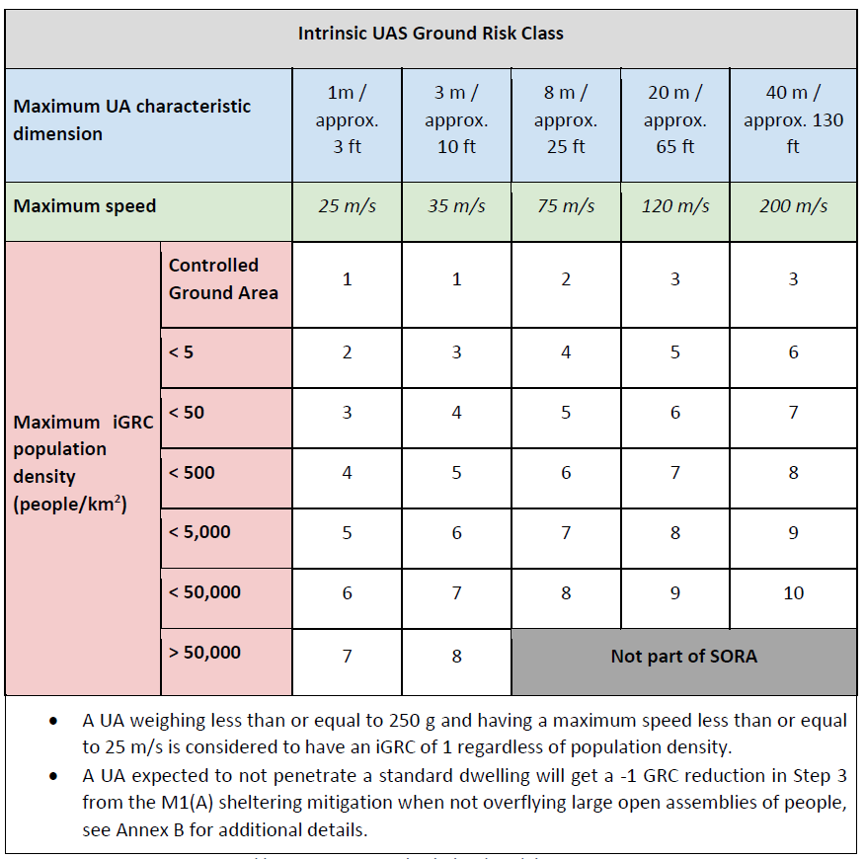
DRONES – THE CHALLENGES
2 Determination of intrinsic Ground Risk Class (iGRC)
The risk of a person being struck by the UAS.
Relates to “area at risk” - UAS size, and population density.
Can mitigate with sheltering, parachute, frangibility etc.

Slide 24
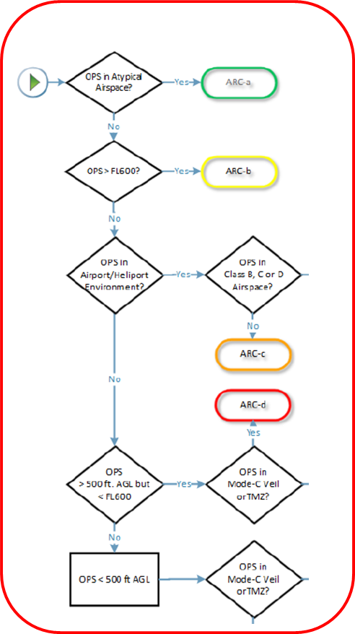
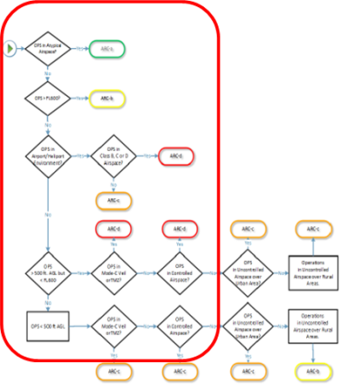
DRONES – THE CHALLENGES
Determination of
Initial Air Risk Class (ARC)
ARC a airspace where the risk of collision between UAS and manned aircraft is acceptable without additional tactical mitigation.
ARC a b c d represent airspace with increasing risk of collision between UAS and manned aircraft
4 Possible Results:
ARC a b c d

Slide 25
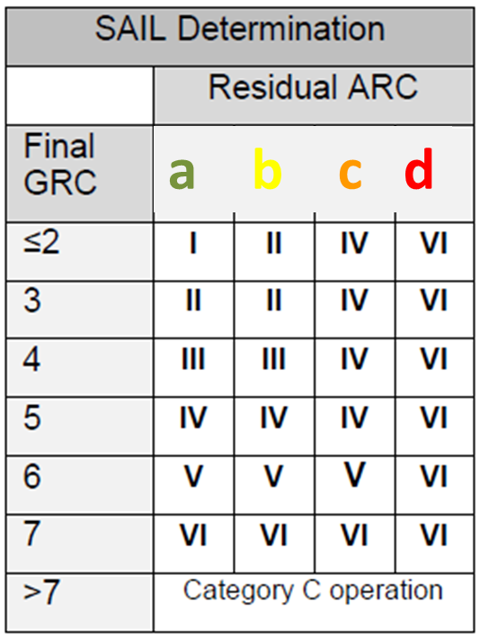
DRONES – THE CHALLENGES
Specific Assurance & Integrity Levels (SAIL)
The SAIL value is overall result of the ground and air risk analyses. It represents the required level of confidence that the operation will remain under
control (safe). The SAIL score determines the OSOs to met and the level of confidence required of their robustness.
SAIL III and IV
Medium Risk
DVR required
Design
Verification
Report
(a type certificate in all but name)
Roman numerals indicate the SAIL determination
SAIL V and VI need a
Type Certificate
5a = SAIL IV

Slide 26
QUESTIONS
nbreyley@cyclopsair.com

