Slide 1


THE LEGAL LANDSCAPE OF THE EASTERN CARIBBEAN CIVIL AVIATION AUTHORITY: AN OVERVIEW

Slide 2

CONTENT GUIDE
AVIATION LAW ASPECTS OF AVIATION LAW
THE GENESIS OF ECCAA THE ECCAA’S FUNCTIONS ECCAA’S LEGAL &REGULATORY FRAMEWORK NEW REGULATORY CONSIDERATIONS.
CONCLUSION

Slide 3

AN INTRODUCTION TO AVIATION LAW

Slide 4

Aviation Law: Key Principles and Technical Aspects
International and National Legal Foundations
Technical Language and Industry Practices
Comprised of both international and domestic standards and recommended practices, regulations policies that guide a global air transport. Includes widely recognized sources of international law, as well as national and supranational legal and political cultures. Multilateral treaties govern airline safety, security, liability, and aircraft financing/acquisition & leasing. E.g.Article 83 bis States have rights and duties regarding control of their sovereign airspaces. Reference: The Principles and Practice of International Aviation Law by Brian F. Havel & Gabriel S. Sanchez.
Aviation law uses specific technical language for each discipline. Established modes of practice, comity, and principles tailored to the aviation sector. Technical rules ensure compliance with international safety and operational standards. Industry-specific regulations address unique challenges in the aviation Legal principles are designed to adapt to evolving aviation technologies.

Slide 5

Aspects of Aviation Law
Regulations
Key Aspects of Aviation Law
Aviation law governs the operation and use of aircraft and the maintenance of aviation safety.
It includes regulations on pilot licensing, aircraft certification, and air traffic control procedures
Legal responsibilities extend to passenger rights, accident investigation, and international treaties.
Compliance with both national and international aviation standards is required for all operators ranging from airlines, air navigation providers, aerodromes, aircraft owners and licensees.

Slide 6



Aspects of Aviation Law
Property Law, Criminal Law, Administrative
International (Both Public & Private)
Contract Law, Company Law, Insurance
Central to aviation law, governing cross-border air travel and international regulations.
Agreements, corporate structures, and risk management in aviation.
Covers ownership, criminal offenses, and regulatory compliance within aviation .

Slide 7

Aspects of Aviation Law
Overview
International Stakeholders
Includes ICAO, IATA, EASA, ACI .These organizations set global aviation standards and facilitate international cooperation.
National Stakeholders
Comprises Ministries of Civil Aviation, Security, Immigration, & Transport, Airport Authorities, and Civil Aviation Authorities, focusing on national regulations, policies, directives and enforcement.
Private Stakeholders
Consists of Aircraft Owners, aviation-related jobs & employees,, Tech Companies, and Airline Operators/Companies, who drive industry innovation and service to the public

Slide 8

Aspects of Aviation Law
Understanding aviation law is crucial for ensuring safety, security, and efficient air transportation.

Slide 9


Who is the International Civil Aviation Organization (ICAO)?
The International Civil Aviation Organization (ICAO) is the United Nation's Organ established by the 1944 Chicago Convention as the specialized aviation agency that is responsible for the creation, adoption, and implementation of global rules and standards that ensure that the aviation sector is efficient and safe and secure for travel.
The Chicago Convention is an International Treaty that possesses several articles which have created the environment for the development of international aviation.
There are rules are referred to as the Standards and Recommended Practices (SARPs) and are published in 19 Annexes each annex covers a different area of aviation.

Slide 10
Important Chicago Convention Articles
01
02
03
04
05
Article 1
Article 3 bis
Article 10
Article 12
Article 29 & 37
Every state has complete and exclusive sovereignty over airspace above its territory.
Every other state must refrain from resorting to the use of weapons against civil aircraft in flight.
(Landing at customs airports): The state can require that landing to be at a designated customs airport and similarly departure from the territory can be required to be from a designated customs airport
Each contracting State undertakes to ensure the prosecution of all persons violating the applicable regulations
Article 29: Before an international flight, the pilot in command must ensure that the aircraft is airworthy, duly registered and that the relevant certificates are on board the aircraft. Article 37: Adoption of international standards and procedures - The responsibility of a State for the safe, regular and efficient conduct of flight operations is implicit in its acceptance of SARPS
Recognition of national airspace sovereignty
Prohibition of force against civil aircraft
Requirement for designated customs airports
Enforcement of aviation regulations
Compliance with airworthiness and international standards

Slide 11
ICAO Annexes
01
02
03
04
05
Annexes 1-4
Annexes 5-8
Annexes 9-12
Annexes 13-16
Annexes 17-19
Annex 1 - Personnel Licensing Annex 2 - Rules of the Air Annex 3 - Meteorological Services Annex 4 - Aeronautical Charts
Annex 5 - Units of Measurement Annex 6 - Operation of Aircraft Annex 7 - Aircraft Nationality and Registration Marks Annex 8 - Airworthiness of Aircraft
Annex 9 - Facilitation Annex 10 - Aeronautical Telecommunications Annex 11 - Air Traffic Services Annex 12 - Search and Rescue
Annex 13 - Aircraft Accident and Incident Investigation Annex 14 - Aerodromes Annex 15 - Aeronautical Information Services Annex 16 - Environmental Protection
Annex 17 - Security Annex 18 - The Safe Transportation of Dangerous Goods by Air Annex 19 - Safety Management
List of Annexes 1-4
List of Annexes 5-8
List of Annexes 9-12
List of Annexes 13-16
List of Annexes 17-19

Slide 12
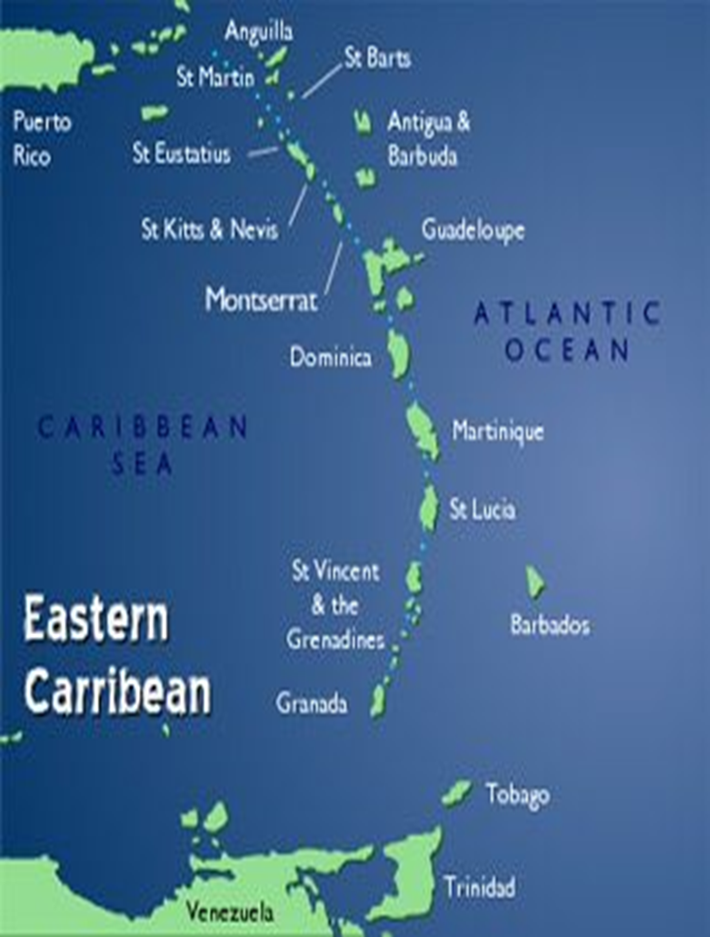
ECCAA’S GENESIS & FUNCTIONS
Established in Grenada in 2003, by the Eastern Caribbean Civil Aviation Agreement signed by the Civil Aviation Ministers but did not achieve its legal autonomous status until 2004 when the Eastern Caribbean Civil Aviation Act and Agreement Act came into effect.
The Eastern Caribbean Civil Aviation Authority (ECCAA) is the aviation regulatory body for six States in the Caribbean region. These are:
Antigua and Barbuda 4. Saint Kitts and Nevis
Commonwealth of Dominica 5. Saint Lucia
Grenada 6. Saint Vincent & the Grenadines
Therefore, it performs oversight, certification, monitoring, licensing regulation and is a key technical adviser to its Member States.
The main divisions within the Authority are the Officer of the Director General, the Flight Safety Division, the Air Navigation Services, Aerodrome and Aviation Security.
The ECCAA also provides Communication, Navigation & Surveillance Services to these States as well as:
1. Anguilla
2. British Virgin Islands
3. Montserrat

Slide 13

ECCAA’s Legal & Regulatory Framework
The Eastern Caribbean Authority’s legal framework is established in two main acts
The Eastern Caribbean Civil Aviation Authority Agreement Act as amended & the Eastern Caribbean Civil Aviation Act as amended.
The Act would have provided power to both the Director General & the Minister of Civil Aviation of each State the powers to regulate, prescribe, implement and direct policies and provide the environment to ensure that core functions of the Eastern Caribbean Civil Aviation Authority is being achieved.
The Acts are also complimented by Regulations which are subsidiary legislation, which detail aptly the Standards and Recommend Practices that are required to be adopted by ICAO in order to be complicit with the international standard and treaty obligations.
E.G of these Regulations are the Flight Safety Regulations 2024, ANS Regulations 2024 & 2025 and Security Regulations
ECCAA’s legal and regulatory framework establishes the rules and guidelines for civil aviation oversight and safety in the Eastern Caribbean. This framework is designed to align with international standards, ensuring safe, secure, and efficient air transport in the region.

Slide 14

REGULATORY REVIEW & AMENDMENTS
Current Status of State Compliance
PRESENTLY THE ECCAA WOULD HAVE UNDERGONE AN AMENDMENT PROCESS TO FLIGHT SAFETY REGULATIONS AND ALSO THE CREATION OF NEW ANS REGULATIONS. PLEASE SEE THE TABLE TO SEE THE STATUS OF STATE COMPLIANCE TO THE PROMULGATION OF REGULATIONS NB: THE SECURITY REGULATIONS ARE SCHEDULED TO BE REVIEWED FOR UPDATE | STATES | FLIGHT SAFETY REGULATIONS | ANS REGULATIONS | ANTIGUA & BARBUDA | 100% | 100% | | THE COMMONWEALTH OF DOMINICA | 100% | 100% | | GRENADA | 100% | 100% | | SAINT LUICA | 100% | 40% | | SAINT KITTS & NEVIS | 100% | 100% | | SAINT VINCENT & THE GRENADINES | 100% | 100% |

Slide 15




Symbiotic Relationship: ECCAA & Civil Aviation Ministries
Director General: Issue Directives & Aviaiton Doucments
Minister: Air Service Licenses & Permits
Responsible for issuing aviation document and Directives
Grants air service licenses and permits, and oversees the establishment and maintenance of aerodromes.
Oversight & Regulation
Ministerial Authority & Review
The Director General appoints inspectors (Section 12),
enforces regulations, and suspends aviation documents when necessary (Section 38).
The Minister establishes the Air Transport Licensing Board, reviews suspension decisions, and approves licenses.

Slide 16

New Regulatory Considerations
Regulations
CORSIA: Carbon Offsetting and Reduction Scheme for International Aviation aims to reduce aviation emissions globally. UAS/RPAS & Drones: New guidelines are being developed for the safe integration of unmanned aerial systems and remotely piloted aircraft.
Article 83 bis Agreements
Adoption of Data Protection Protocols and considerations.
Ongoing updates to regulatory framendi works ensure both environmental responsibility and technological advancement in aviation.
Aerodrome Licnesing and certification

Slide 17

THANK YOU

