Slide 1


The Dynamic Legal Landscape of
Drones and Remotely Piloted Aircraft Systems (RPAS)

Slide 2

Understanding the Technology
Remotely Piloted Aircraft Systems (RPAS): An aircraft piloted from a remote pilot station (ICAO Annex 2) and it encompasses operational and regulatory frameworks for the aircraft. Known as Drones or Unmanned Aircrafts Systems | Drones (unmanned aerial vehicles (UAVs) or quadcopters): An aircraft that can fly without an onboard human pilot. A remote-controlled aircraft. | Unmanned Aircraft System (UAS) A system that includes the aircraft plus its control station, communications, and any supporting equipment.

Slide 3
APPLICATIONS ACROSS SECTORS
CIVIL
COMMERCIAL
RECREATIONAL

Slide 4

APPLICATIONS ACROSS SECTORS
CIVIL APPLICATIONS:
Emergency response
Infrastructure inspection
Environmental monitoring
ICAO emphasizes airspace integration, risk management, and operator accountability for these missions, especially when operating near populated areas or controlled airspace.

Slide 5
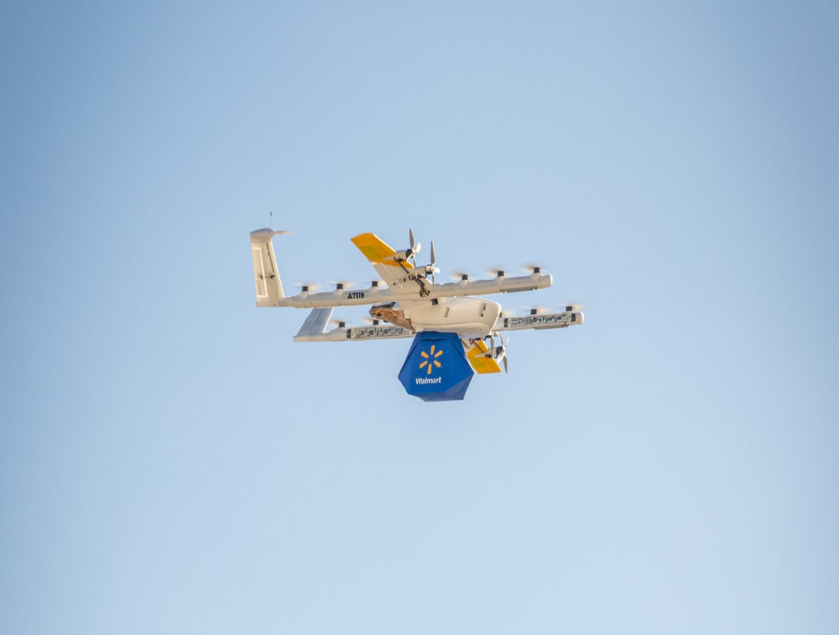
APPLICATIONS ACROSS SECTORS
COMMERCIAL APPLICATIONS:
Delivery services
Aerial photography and videography
Surveying and mapping
Agricultural operations
ICAO encourages registration, remote pilot certification, and operational limitations to ensure safety and compliance.

Slide 6
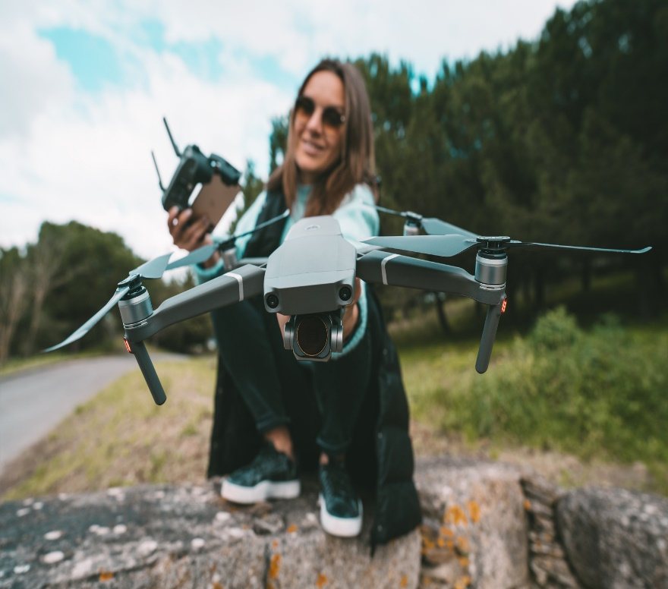
APPLICATIONS ACROSS SECTORS
RECREATIONAL APPLICATIONS:
Flying for fun
Drone racing
Photography and videography
ICAO suggests basic safety rules, visual line-of-sight operations, and restrictions on altitude and proximity to airports to minimize risks.

Slide 7

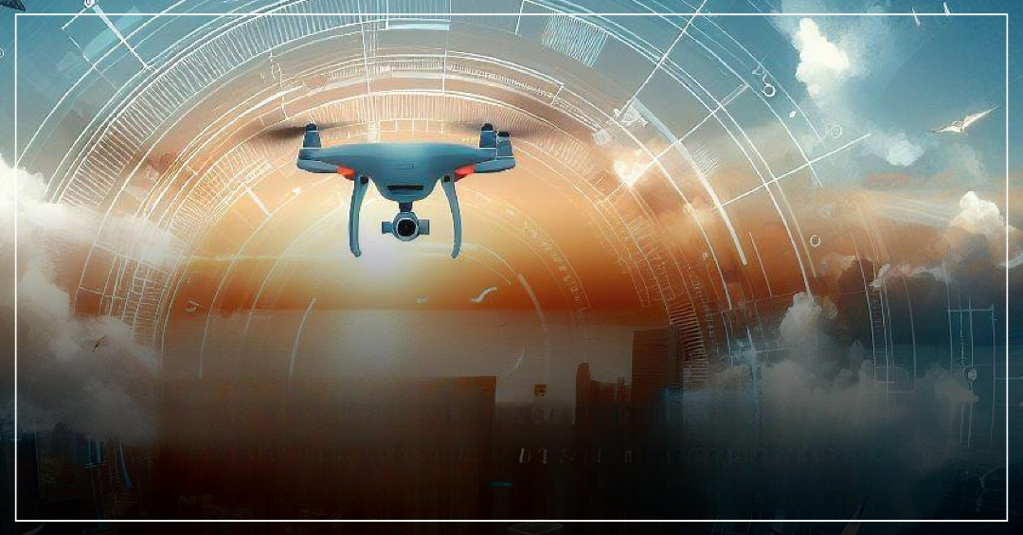
Growth and Technological Evolution
Growth and
Technological Evolution

Slide 8
Legal Foundations of RPAS Regulation
INTERNATIONAL FRAMEWORKS
THE MANDATE OF NATIONAL AVIATION AUTHORITIES

Slide 9

Legal Foundations of RPAS Regulation
International Frameworks
Article 8 of the Chicago Convention
ICAO Annex 2 (Rules of the Air)
ICAO Annex 7 (Aircraft Nationality and Registration Marks)
ICAO Annex 13 (Aircraft Accident and Incident Investigation)
ICAO Annex 17 (Security)
ICAO Model UAS Regulations
ISO standards provide global norms for UAS operations and safety.

Slide 10

Legal Foundations of RPAS Regulation
National Authority Mandates
Derived from primary legislation covering registration, airworthiness, pilot certification, operational approvals and enforcement powers.
Risk Based Approach and Prescriptive requirements.
Distinction between Commercial and Recreational Operations
Open and Specific Categories of Operations

Slide 11

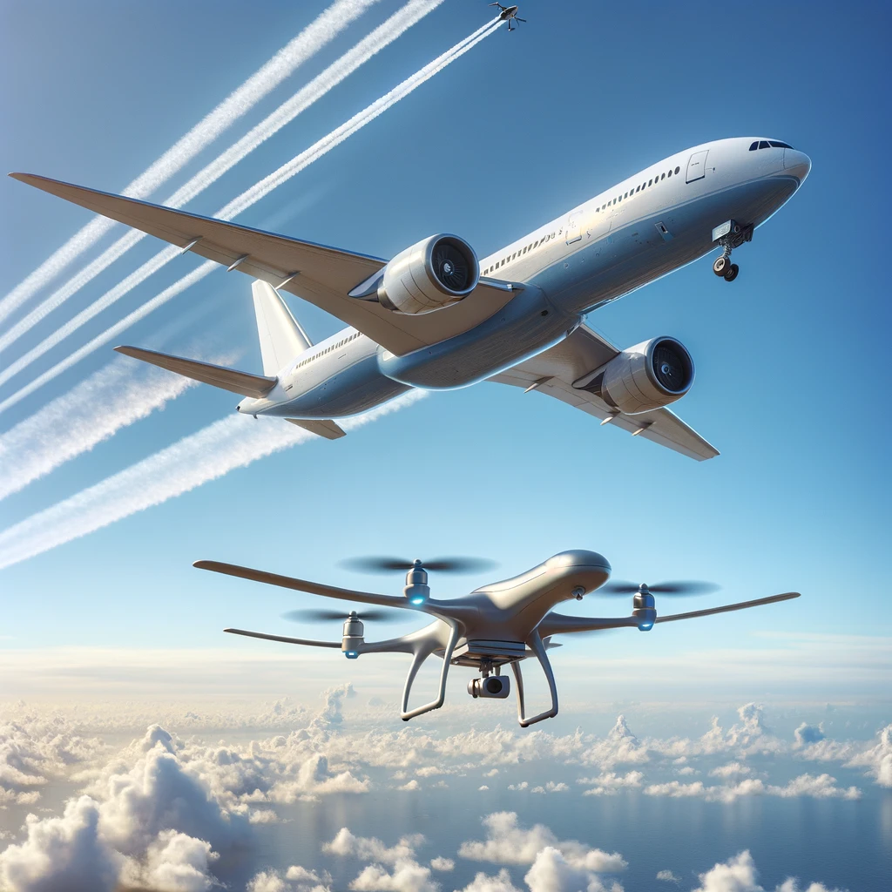
Key Regulatory Challenges
Airspace Integration and Safety
Geofencing
Privacy and Data Protection
Unauthorized Surveillance
Transparency and Privacy

Slide 12

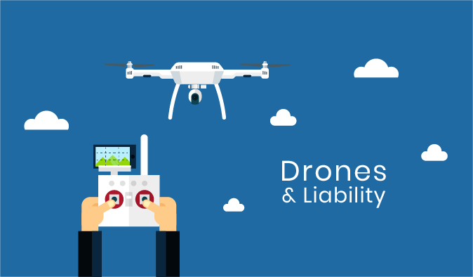
Key Regulatory Challenges
Liability and Insurance
Ambiguities around Malfunction and Operator Fault
Emerging Insurance Models for Risk Coverage
Legal Attribution of Fault in Accidents or Data Breaches
Evolving Case Law and Further Standards

Slide 13
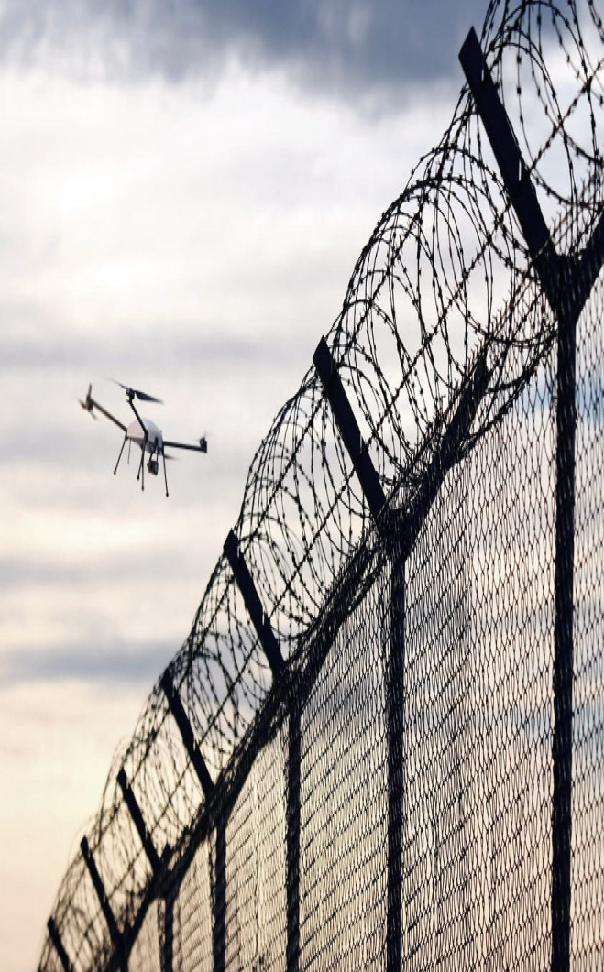
Key Regulatory Challenges
Cross-Border Jurisdiction
Enforcement Difficulties in Global Operations
Remote Piloting and Jurisdictional Conflicts
Global Harmonization Efforts
Barbados-Specific Registration Protocols

Slide 14


THE FUTURE OF DRONES
Emerging Technologies
Future Applications
Regulation and Ethics

Slide 15

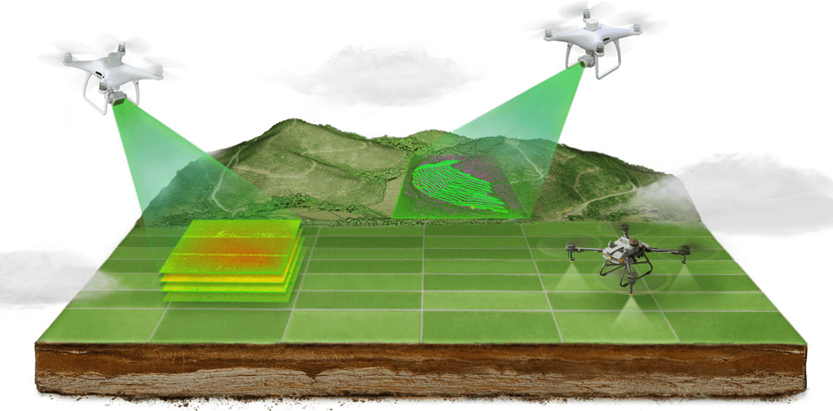
The Sky Is the New Frontier
Harmonized air law and international collaboration.
Evolution of cyber-security protocols in aviation.
Drones promise efficiency, safety and accessibility, but their success depends on how we regulate, innovate and use them responsibly.

Slide 16
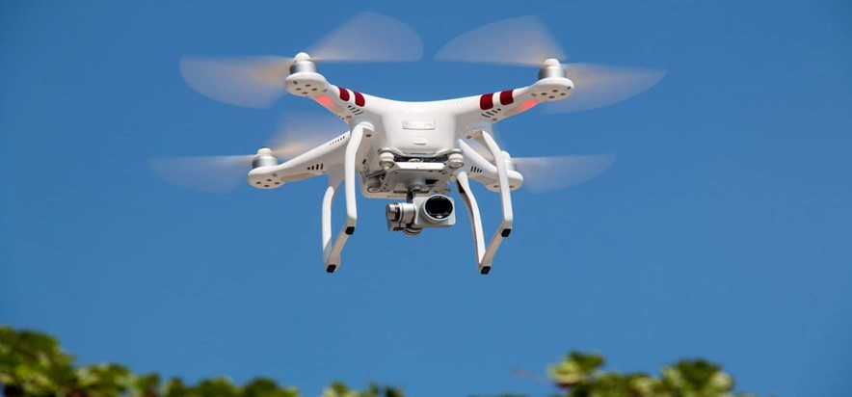
THANK YOU

