Slide 1
The Flight Path to Compliance: Overcoming Barriers to SMS Implementation
Daniella Boswell
Eastern Caribbean Civil AVIATION AUTHORITY
Legal Seminar November 14, 2025

Slide 2

Thank you

Slide 3
SMS Components 4/12 Elements
Safety Policy & Objectives
Safety Risk Management
Safety Assurance
Safety Promotion

Slide 4
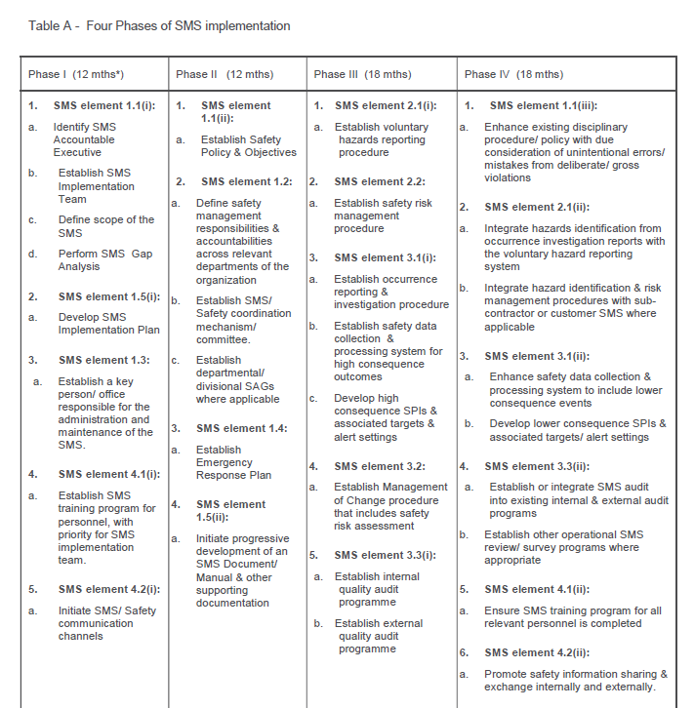
4 Phase Implementation

Slide 5
SMS is a Mandatory Requirement
Compliance
Implementation
Continuous Improvement
Common Barriers
Practical Strategies

Slide 6
Top 4 Barriers
Barriers
Insufficient financial resources
Insufficient human resources
CAA support/information
Insufficient Understanding of SMS*

Slide 7

True Story

Slide 8

Barriers/Strategies to Implementation
Middle-point madness
Strategies
Regulatory complexity: Understand what the requirements and apply the laws
-ICAO Annex 19, Doc 9859
-CARS
Define the scope of your SMS
Define the person responsible for implementation
Start Fresh
RIP It!

Slide 9

Barriers/Strategies to Implementation
Change… Why?
Strategies
Read books of influencing change
Listen
Involve relevant parties to be part of the process of change
Monitor change

Slide 10

Barriers/Strategies to Implementation
Lonely road of SMS
Strategies
Leadership Training
Leadership Commitment and Visibility
Linking SMS Goals to company goals
Create integration chart
Be strategic when selecting member for your safety committees

Slide 11

Barriers/Strategies to Implementation
SMS is invisible….until!
Strategies
Seeing is believing –Power of SPIs
Review Cases Study for relevance (jail time)…

Slide 12
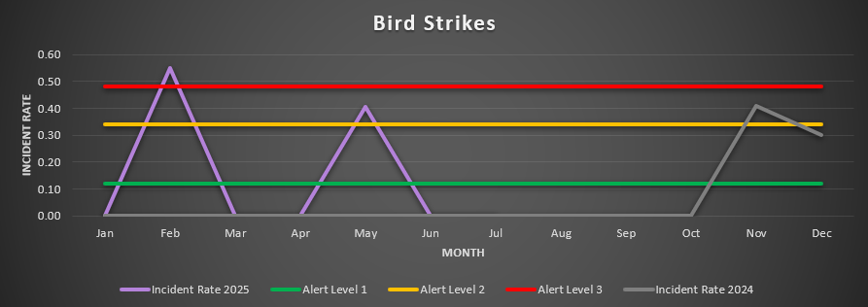
Safety Performance Indicators

Slide 13

Barriers/Strategies to Implementation
The “Informer” Label
Strategies
Policy
Increase awareness about system
Be ready for the tests

Slide 14

Barriers/Strategies to Implementation
Resource Constraints
Strategies
On the side of the Safety Managers
No conflicting duties….
Need to focus
Predetermine priorities

Slide 15
Understanding what you need to understand
Define your regulatory requirements (Ask for guidance)
Determine your starting point (APEX in Safety)
Develop your blueprint (GAP Analysis and Implementation plan)

Slide 16
Overcoming Barriers
Reduce safety incidents and operational risks
Increase Legal compliance and avoidance of penalties
Improved operational efficiency
Stronger organizational safety culture

Slide 17
The apple and the seed
Annex 19 & Doc 9859 combined with your CARs provide adequate documentation and guidance to lead to a fully implemented SMS.
However, you will require qualified and competent individuals to manage the implementation. This individual should be a catalyst for change and an excellent communicator, they should be diligent & forward-thinking
Anyone can see the seeds in an apple;
Wisdom sees the apples in a seed” ~Anonymous
Your Safety Manager should be able review all the relevant docs and visualize a fully implemented system.

Slide 18
Conclusion
The Flight path to SMS compliance is navigable – with leadership, culture, and tools, barriers can be overcome to ensure safer airports and skies

Slide 19

Thank you

